Slide 1
Embedded System Laboratory
2020 Summer Training
Lecture 1: Kernel Build, Load & GPIO Control
Made by 許家偉 2020/7

Slide 2
Outline
Specification of Raspberry Pi 3 Model B+
Implementation
Kernel Building
Boot Procedure
Build Raspberry Pi OS Image
Circuit & Pins
Hands-on Time
Homework
Sincere Blessings

Slide 3
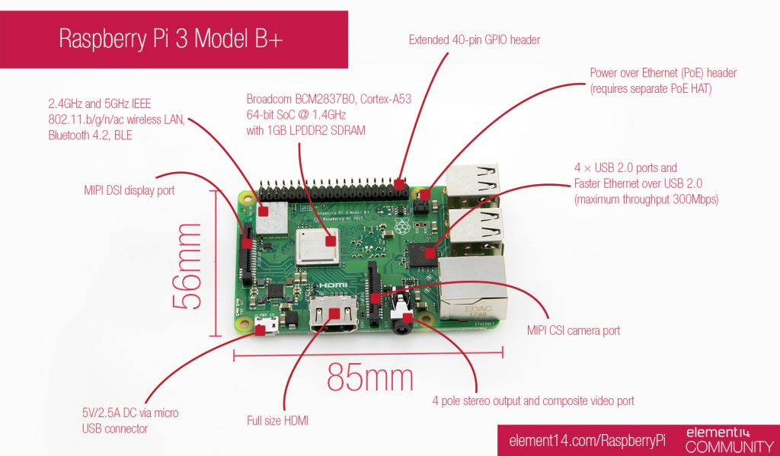
Specification of Raspberry Pi 3 Model B+

Slide 4
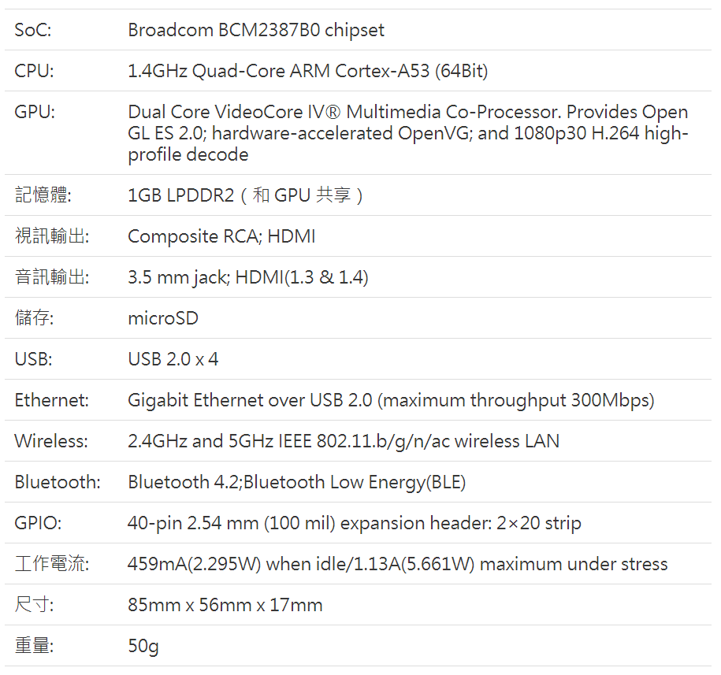
Specification of Raspberry Pi 3 Model B+

Slide 5
Implementation
Written in ARM assembly language
.equ : assigns a value to a symbol , i.e abc .equ 5 , abc now represents five
ldr : loads from memory
str : writes to memory
cmp : compares two values by performing a subtraction. Sets flags.
b : branch to label
add : performs arithmetic
Reference: 成大資工 Wiki – ARMv8 , ARM.Reference_Manual.pdf

Slide 6
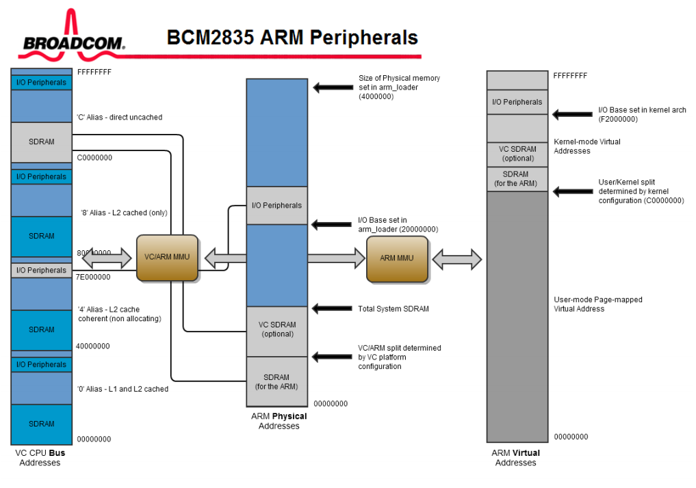

Slide 7
Implementation
Base address of GPIO : 0x3f200000
How to access GPIO ?
SELECT reg. : select GPIO for input/output
SET reg. : set GPIO for high vol.
CLEAR reg. : clear GPIO for low vol.

Slide 8
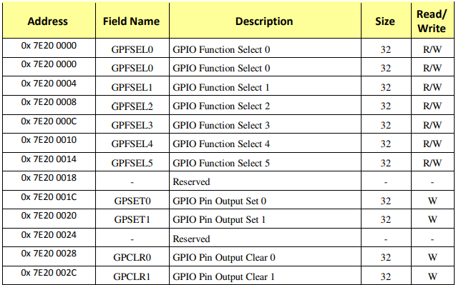
Implementation
Notes:
看offset就好

Slide 9
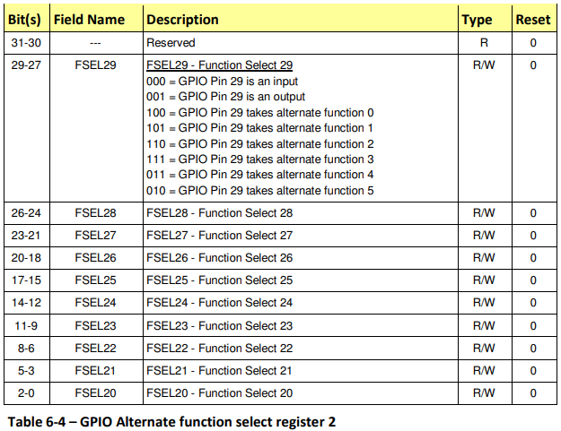
Implementation
Notes:
看offset就好

Slide 10
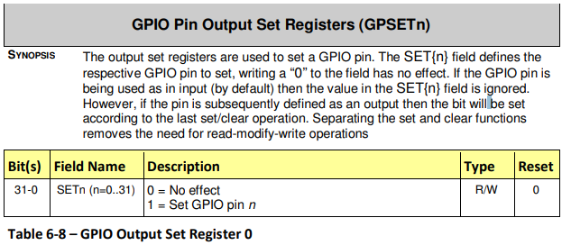
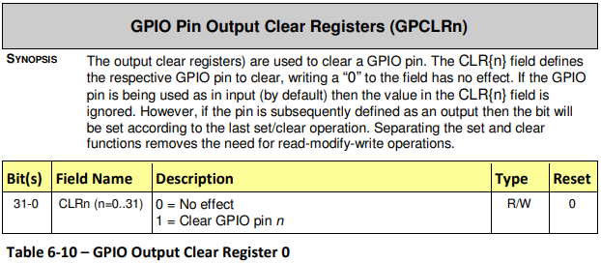
Implementation
Notes:
看offset就好

Slide 11
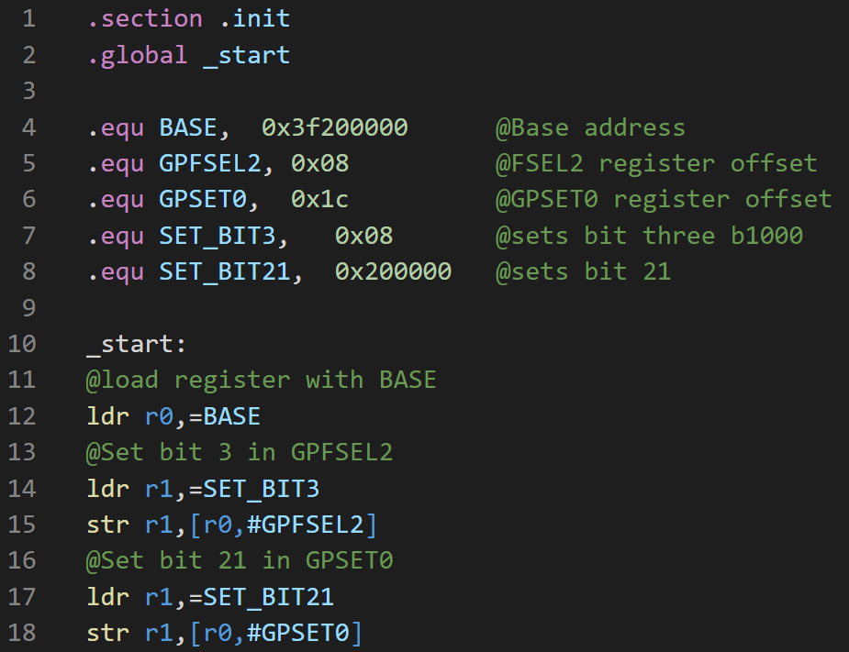
Notes:
.section .init tells the pi where to put the code
.global _start
.equ 增加程式可讀性

Slide 12
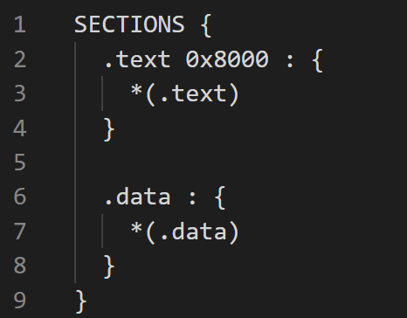
Implementation
ARM linker usually uses 0x8000 to start kernel(OS)
kernel.ld

Slide 13
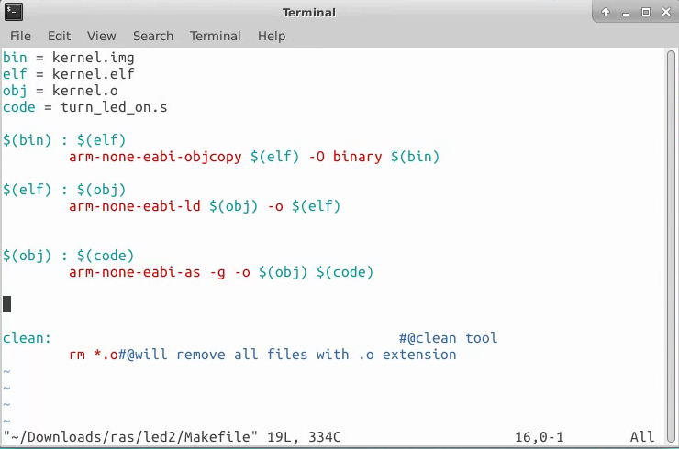
Kernel Building
Install arm-none-eabi , The GNU Arm Embedded Toolchain
~$ make

Slide 14
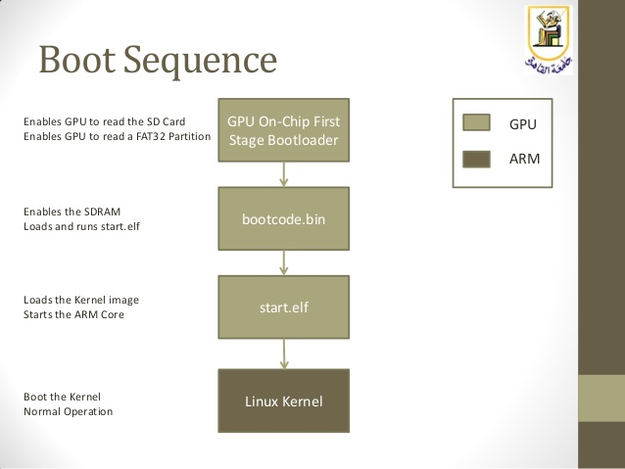
Boot Procedure
Notes:
首先當我們將板子 power on 後， ARM 的處理器目前是 off 的狀態，而 SDRAM 是 disable 的狀態， 而是利用 GPU 來進行 start booting
GPU 去 ROM 裡執行第 1 階段 bootloader
接著 GPU 又會去 SD 卡中讀 FAT32 第 1 分區的 bootcode.bin (可讀到SD卡會亮綠燈)
bootcode.bin 是第 2 階段 bootloader 他做兩件事
1. enable SDRAM
2. 載入且執行 start.elf
第 3 階段 bootloader 是 start.elf， 讀 kernel image(kernel.img)， configuration 檔 （config.txt）， 和 kernel command line 參數 (cmdline.txt)， 把這些都載入記憶體然後再喚醒 ARM 核心

Slide 15
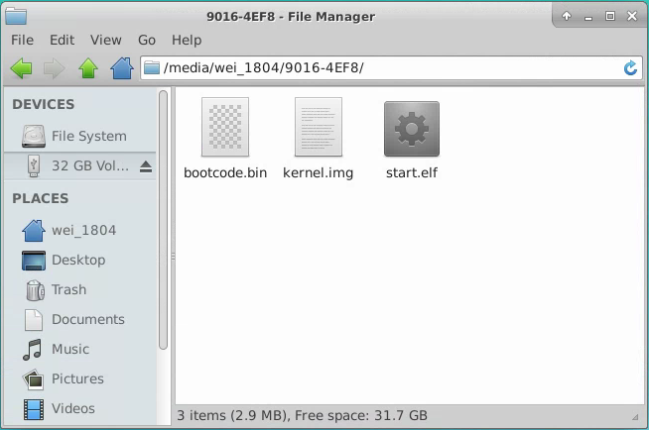
Boot Procedure
Format SD card to FAT32 file system
sudo mkdosfs -F 32 -v /dev/sdd1
df -Th : list information of disk partition
Copy file into SD card
bootcode.bin
start.elf
kernel.img

Slide 16
Build Raspberry Pi OS Image
Purpose: get bootcode.bin & start.elf
Download image
unzip 2020-05-27-raspios-buster-lite-armhf.zip
sudo mkdosfs -F 32 -v /dev/sdd1
umount /dev/sdd
dd bs=4M if= 2020-05-27-raspios-buster-lite-armhf.img of=/dev/sdd conv=fsync

Slide 17
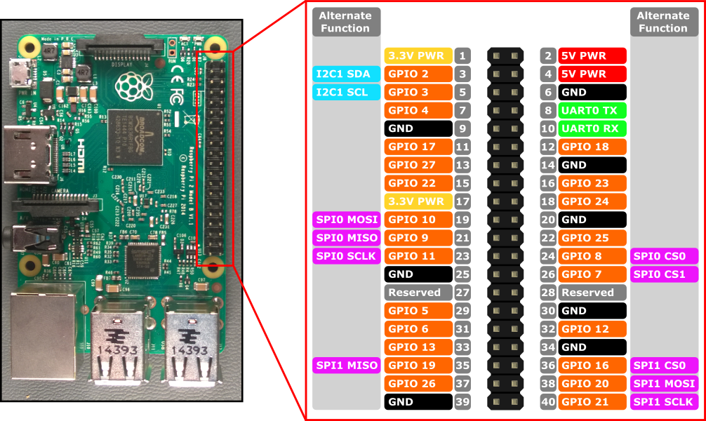
Circuit & Pins

Slide 18


Hands-on Time

Slide 19

Homework
摩斯電碼
Make LEDs blink, show the word
“RTES”in Morse code.
Care the time interval (1 time & 3 times)
Write comments
Shorten your code (hint: use macro)
Explain your code

Slide 20
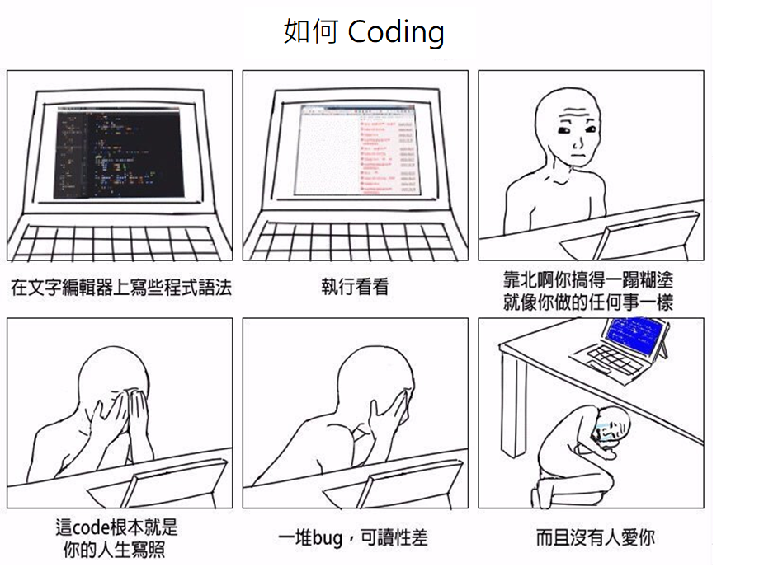
Sincere blessings

